Slide 1
Overview of Oil Spill Response Techniques
CGPRT(W) : Ensuring Clean Seas and Coasts in Western Region ……

Slide 2
Objective
To give you an overview of oil spill response techniques available to responders.
CGPRT(W) : Ensuring Clean Seas and Coasts in Western Region ……

Slide 3
Oil Spill Response Techniques
The following principal response options are available:
Aerial surveillance, tracking and forecasting
Containment and recovery
Dispersants
In situ burning
Protection of sensitive resources
Wildlife response
Shoreline clean-up
CGPRT(W) : Ensuring Clean Seas and Coasts in Western Region ……

Slide 4
Aerial Observation
First response option
Collect key information about the spill:
Confirm source;
Scale of spill;
Oil trajectory;
Oil behaviour;
Support equipment deployment and
Strategic planning.
CGPRT(W) : Ensuring Clean Seas and Coasts in Western Region ……

Slide 5
Aerial Observation
Helicopter or fixed wing aircraft
Trained observers or sensors (UV, SLAR, IR, etc.)
Safety (twin engine aircraft)
Must relay information quickly to command centre.
CGPRT(W) : Ensuring Clean Seas and Coasts in Western Region ……

Slide 6
Containment and Recovery
Mechanical techniques for containing, collecting and recovering oil at sea or in the nearshore
Tools :
Boom
Skimmers
Pumps/vacuum systems
Sorbents
CGPRT(W) : Ensuring Clean Seas and Coasts in Western Region ……

Slide 7
Containment and Recovery: Boom
Mobile floating barriers intended to contain, concentrate or direct oil on water
Stop spreading
Protect sensitive resources
Many types and sizes and uses
CGPRT(W) : Ensuring Clean Seas and Coasts in Western Region ……

Slide 8
Boom
Uses
On-water containment and recovery
Containment
Redirection
Exclusion
Intertidal
CGPRT(W) : Ensuring Clean Seas and Coasts in Western Region ……

Slide 9
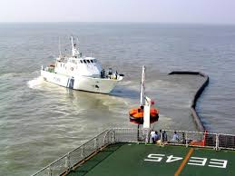
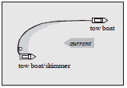
On-Water Containment and Recovery
CGPRT(W) : Ensuring Clean Seas and Coasts in Western Region ……

Slide 10
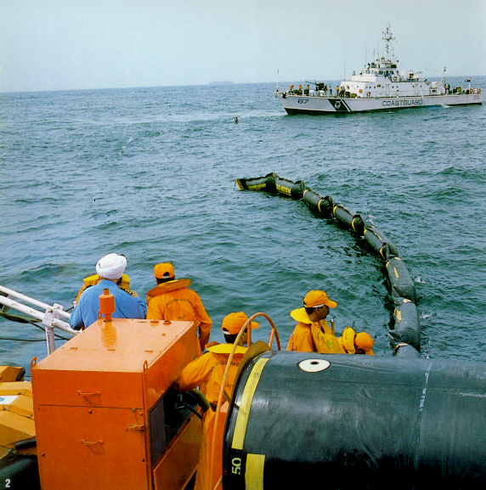
On-Water Recovery
CGPRT(W) : Ensuring Clean Seas and Coasts in Western Region ……

Slide 11
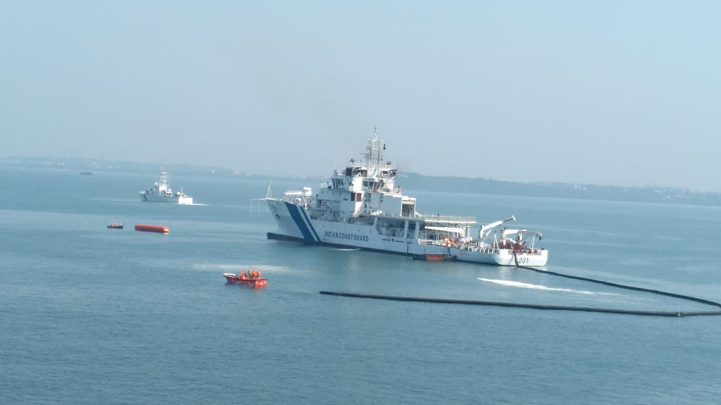
Containment Boom
CGPRT(W) : Ensuring Clean Seas and Coasts in Western Region ……

Slide 12
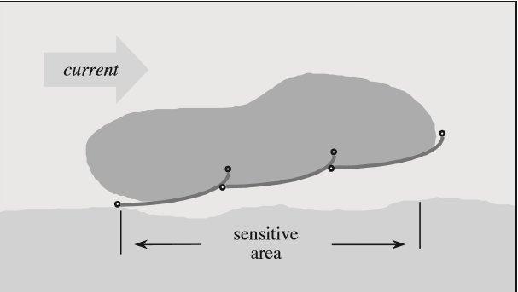
Re-direction
CGPRT(W) : Ensuring Clean Seas and Coasts in Western Region ……

Slide 13
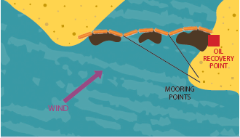
Exclusion
CGPRT(W) : Ensuring Clean Seas and Coasts in Western Region ……

Slide 14
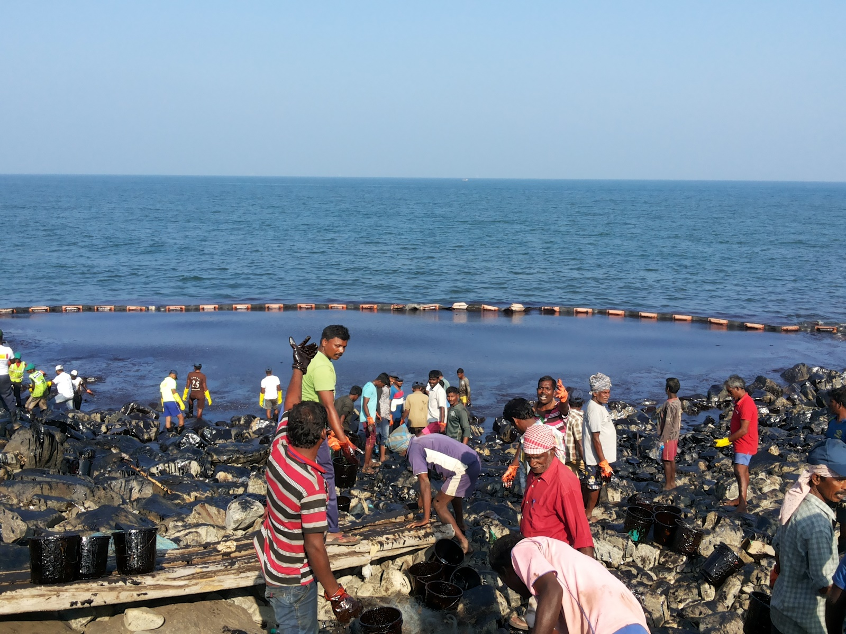
Shoreseal Boom
CGPRT(W) : Ensuring Clean Seas and Coasts in Western Region ……

Slide 15
Other Boom Types
Improvised barriers
Netting systems
Fireproof boom
Sorbents
Bubble barriers
CGPRT(W) : Ensuring Clean Seas and Coasts in Western Region ……

Slide 16
Recovery
Once contained, oil must be recovered
Wide variety of skimmers and pumping/vacuum systems
Limitations:
Oil type
Sea state and weather
Amount of debris
Transport
CGPRT(W) : Ensuring Clean Seas and Coasts in Western Region ……

Slide 17
Recovery - Skimmers
Skimmers are used to collect oil (or oil/water mixture) from the water’s surface.
Oil must be contained and concentrated to a thickness that allows the skimmer to be effective.
Many types of skimmers effective in various conditions.
CGPRT(W) : Ensuring Clean Seas and Coasts in Western Region ……

Slide 18
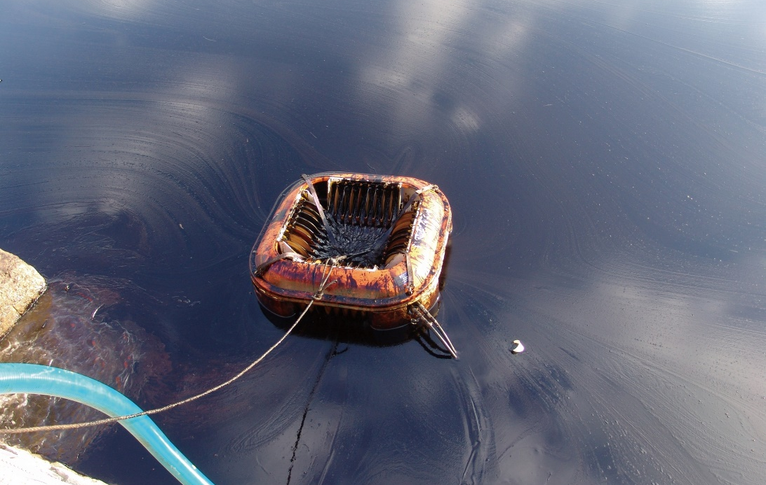
Skimmers
CGPRT(W) : Ensuring Clean Seas and Coasts in Western Region ……

Slide 19
Recovery – Pumps/vacuum Systems
Various types of recovery systems using pumps or vacuum systems.
Based on product type, availability, debris and transport requirements.
CGPRT(W) : Ensuring Clean Seas and Coasts in Western Region ……

Slide 20
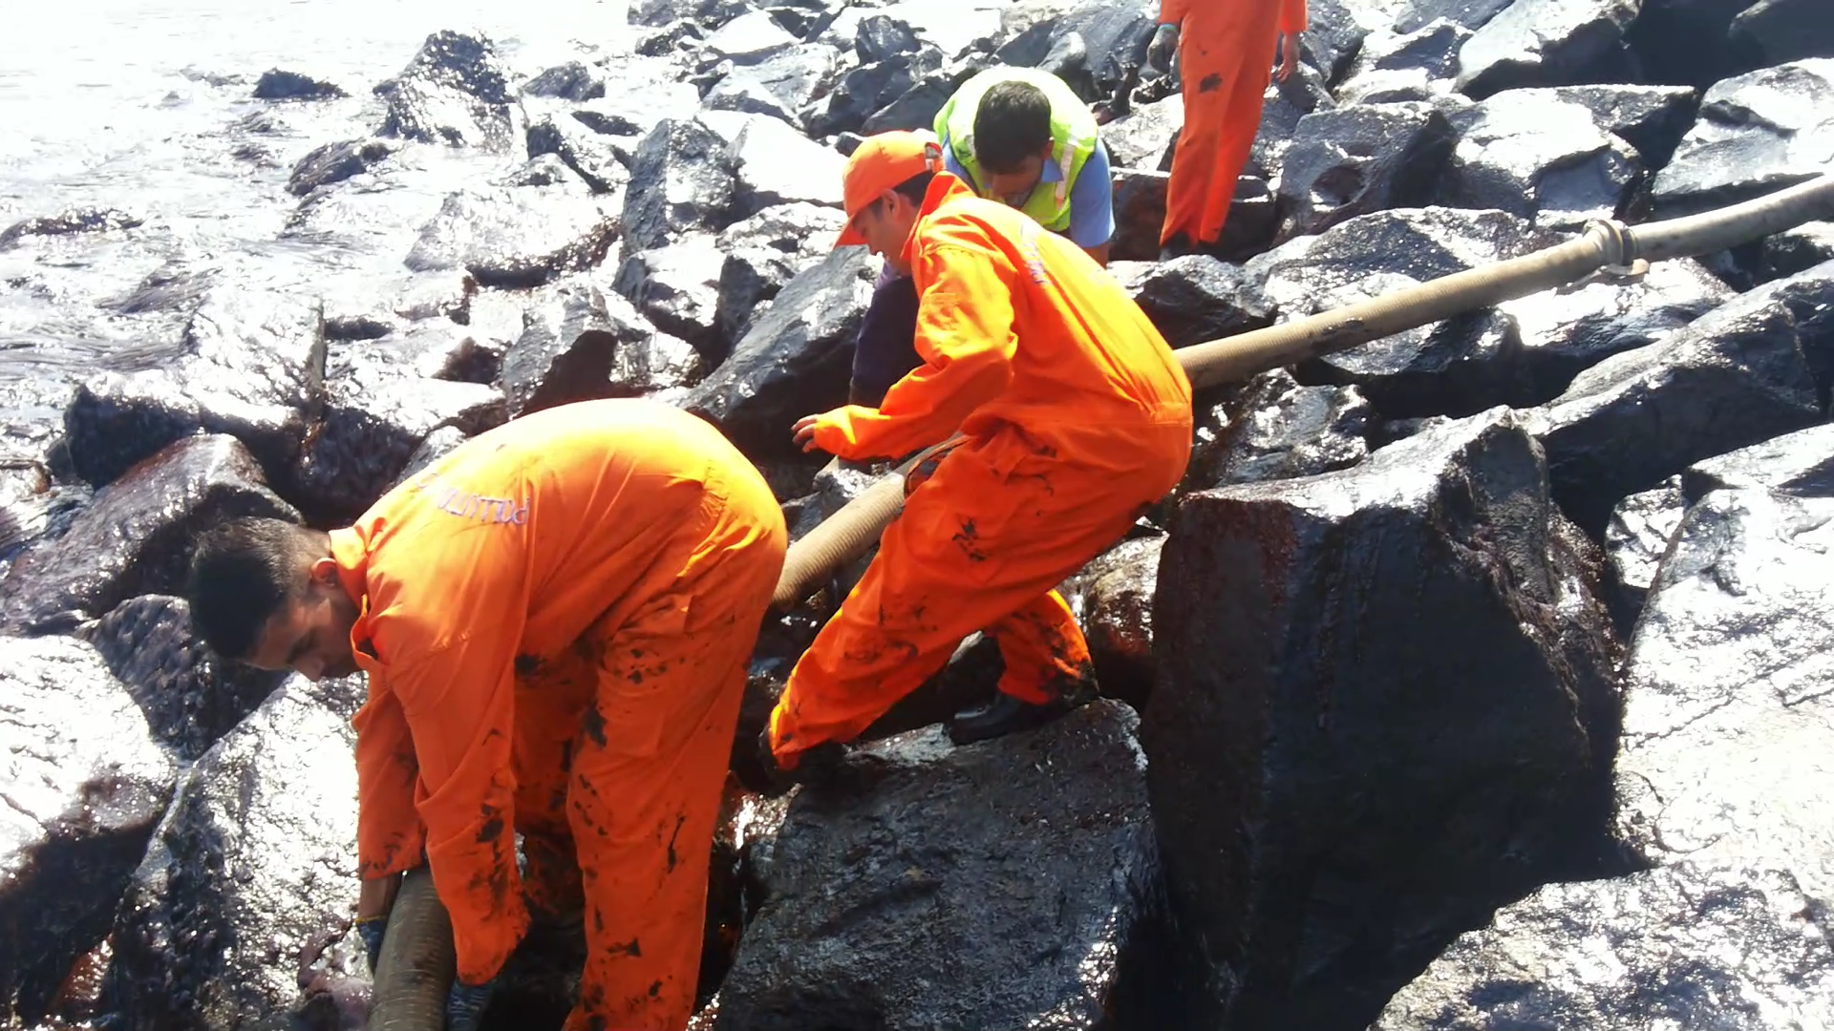
Vacuum Systems/pumps
CGPRT(W) : Ensuring Clean Seas and Coasts in Western Region ……

Slide 21
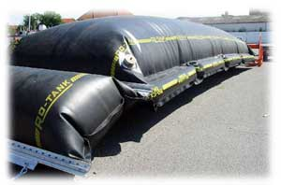
Storage
Temporary storage is required for the recovered product.
Can limit/halt recovery operations and become a bottleneck if adequate storage is not available, ie. Vessels tanks are full.
CGPRT(W) : Ensuring Clean Seas and Coasts in Western Region ……

Slide 22
Dispersants
Dispersants promote the formation of small oil droplets in the water column which will eventually be degraded by naturally occurring micro-organisms
Used appropriately, dispersants can be an effective response to an oil spill and minimize or prevent damage to important sensitive resources.
In common with other response techniques, their use must be considered carefully.
CGPRT(W) : Ensuring Clean Seas and Coasts in Western Region ……

Slide 23
Dispersants
Will require approval
Applied by aircraft or vessel using specialized spray nozzles
Must be used while oil is fresh – concept of “Window of Opportunity”
CGPRT(W) : Ensuring Clean Seas and Coasts in Western Region ……

Slide 24
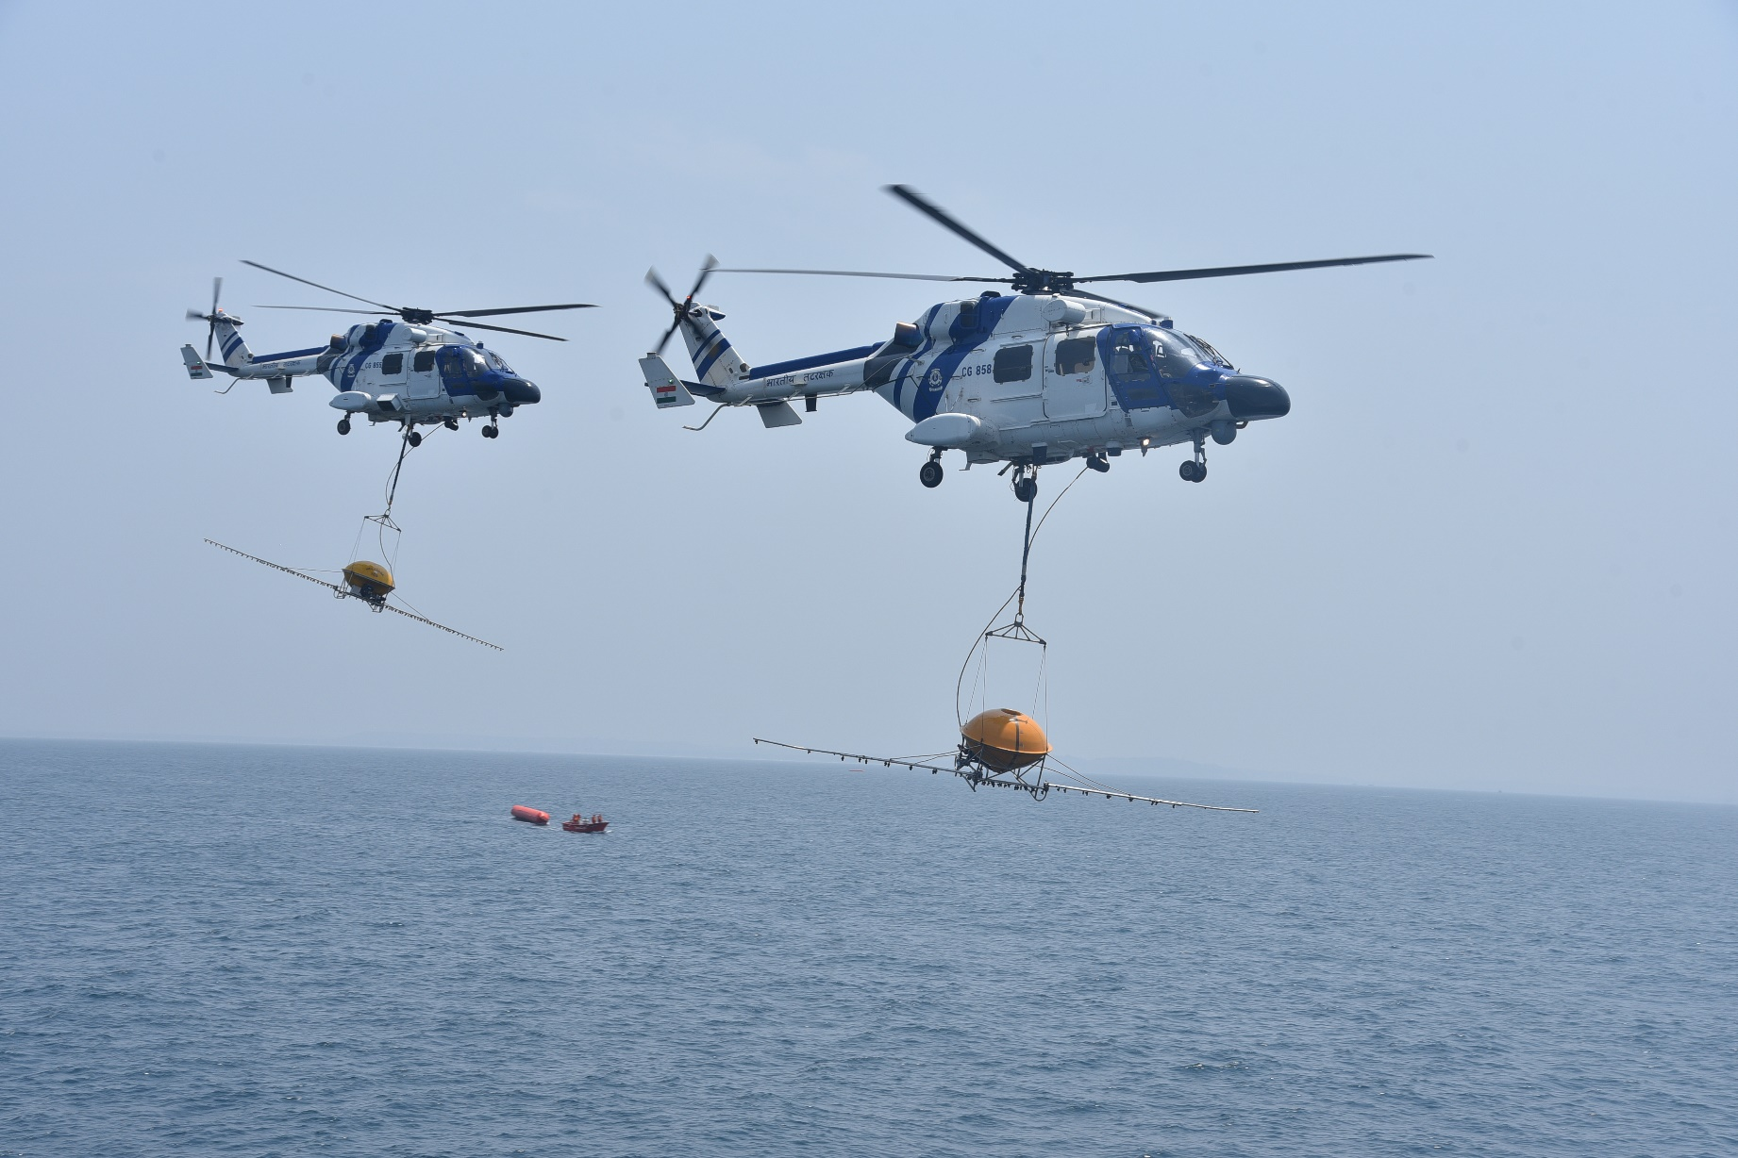
Dispersants
CGPRT(W) : Ensuring Clean Seas and Coasts in Western Region ……

Slide 25
Dispersants
Conflict with other response methods :
Coordination of all response methods is necessary to ensure dispersant use does not conflict with other techniques.
Oil dispersed into the water column cannot be contained by booms or recovered by skimmers.
The effectiveness of Oleophillic skimmers and sorbent materials can be significantly reduced by the use of dispersants.
CGPRT(W) : Ensuring Clean Seas and Coasts in Western Region ……

Slide 26
In Situ Burning- ISB
Consists of burning oil to remove it from land, ice-infested waters or from the water surface.
Generates a large smoke plume containing some VOCs, CO and particulates (soot).
Consumes VOCs and therefore the presence of VOCs may be reduced compared to no burning.
Can leave heavy residues after burning. These could potentially sink.
May require approval.
Health and safety is a priority and air monitoring is essential.
CGPRT(W) : Ensuring Clean Seas and Coasts in Western Region ……

Slide 27
In Situ Burning- ISB
ISB operations can be conducted on water, land or ice.
The effectiveness, efficiency and success rates are dependent on:
the type and properties of the oil
the degree of oil weathering that has occurred
the oil thickness
the response time and equipment availability
the current and forecasted weather and sea state.
CGPRT(W) : Ensuring Clean Seas and Coasts in Western Region ……

Slide 28
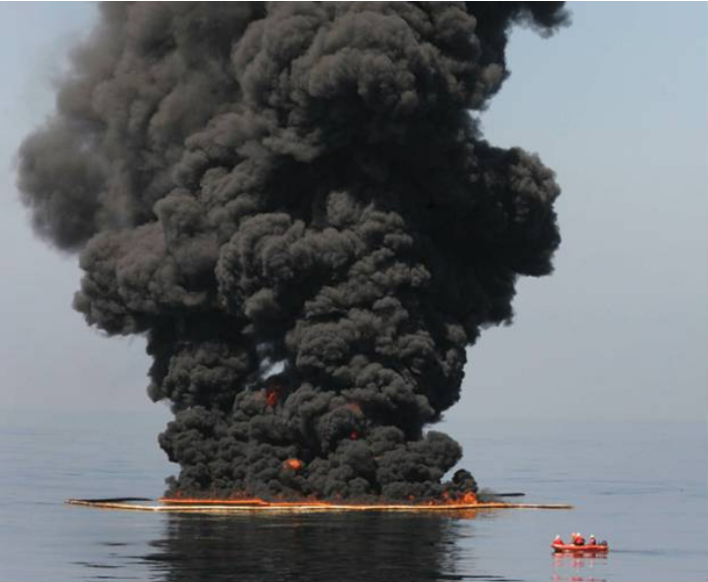
In Situ Burning
CGPRT(W) : Ensuring Clean Seas and Coasts in Western Region ……

Slide 29
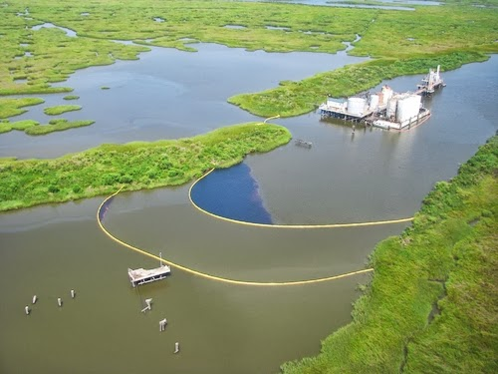
Protection of Sensitive Resources
CGPRT(W) : Ensuring Clean Seas and Coasts in Western Region ……

Slide 30
Protection of Sensitive Resources
Prevent oil from impacting sensitive resources.
Prevent the movement of oil alongshore.
Prevent the movement of oil into an inlet or channel.
Contain oil already stranded.
Use available resources in a safe, efficient, and effective manner.
Minimize waste materials.
CGPRT(W) : Ensuring Clean Seas and Coasts in Western Region ……

Slide 31
Protection of Sensitive Resources
Requires prioritization of sensitivities
An effective use of available resources
A practical use of equipment
Cost effective response
CGPRT(W) : Ensuring Clean Seas and Coasts in Western Region ……

Slide 32
Wildlife Response
Oil released in the marine environment can potentially affect hundreds of thousands of animals, especially birds, and once washed ashore, poses a significant animal welfare and management problem.
Oiled wildlife response planning should have been considered as part of general oil spill preparedness.
CGPRT(W) : Ensuring Clean Seas and Coasts in Western Region ……

Slide 33
Wildlife Response
Planning should include:
the identification of species and areas vulnerable to oil pollution;
actions to protect vulnerable species from oiling during a response;
actions to enhance the treatment of live oiled animals;
actions to enhance assessments of oil spill impact on wildlife populations;
actions to enhance the effectiveness of an oiled wildlife response.
CGPRT(W) : Ensuring Clean Seas and Coasts in Western Region ……

Slide 34
Wildlife Response
Oiled wildlife response includes any activity to deal with wild animals that are/may be affected by oil following an oil spill.
Pro-active measures to minimize the impact of wildlife.
Measures to mitigate the effects of oil on animals.
Response needs to be led by experienced and qualified oiled wildlife responders.
Volunteers can be used under supervision and with training.
CGPRT(W) : Ensuring Clean Seas and Coasts in Western Region ……

Slide 35
Shoreline Clean-up
Objective: Remove oil from shoreline without causing additional damage.
Various techniques available:
Natural
Manual
Mechanical
Flooding/low pressure
High pressure.
CGPRT(W) : Ensuring Clean Seas and Coasts in Western Region ……

Slide 36
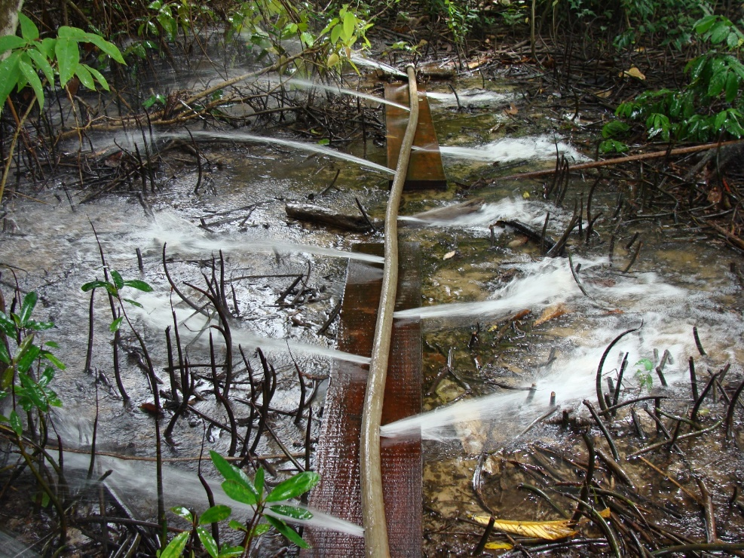
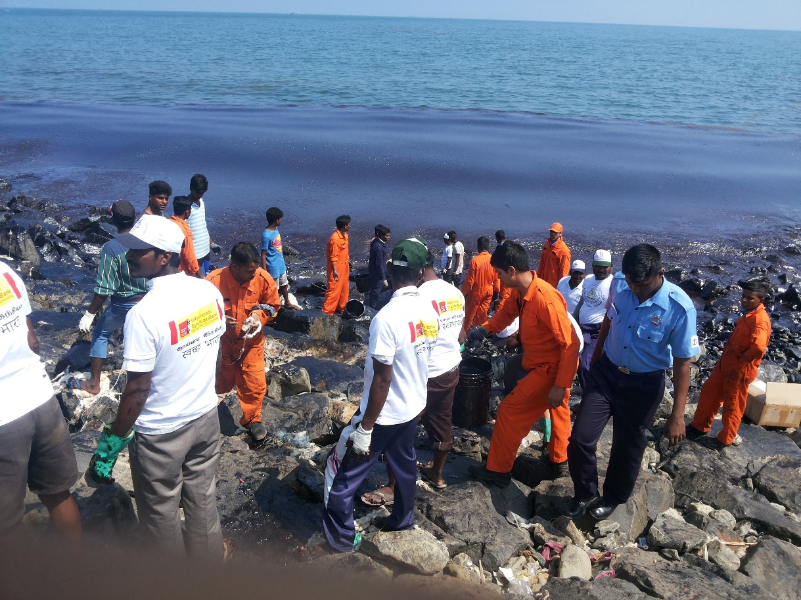
Shoreline Clean-up
CGPRT(W) : Ensuring Clean Seas and Coasts in Western Region ……

Slide 37
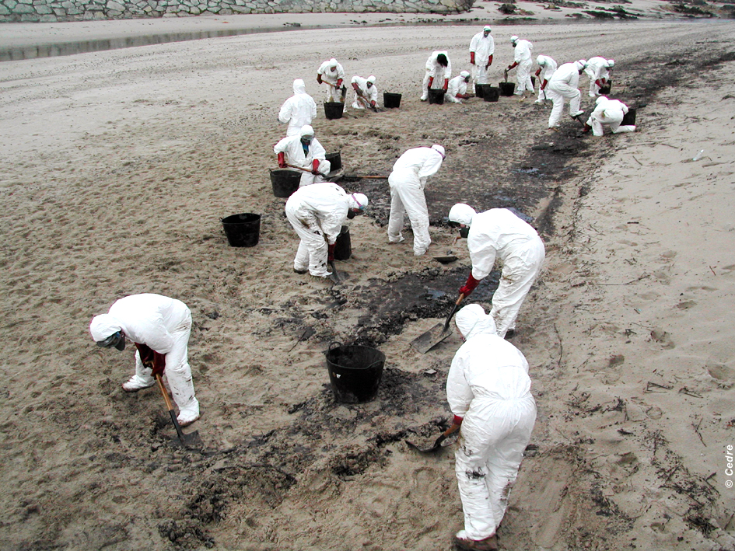
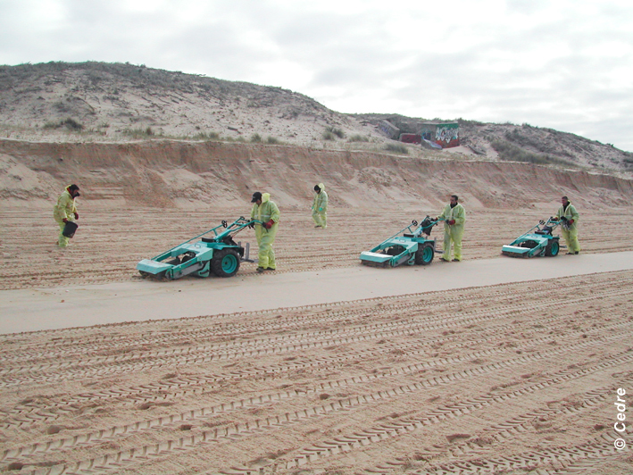
Shoreline Clean-up
CGPRT(W) : Ensuring Clean Seas and Coasts in Western Region ……

Slide 38
Shoreline Clean-up
Shoreline clean-up strategy
Evaluation
Survey (shoreline types, degree of oiling)
Shoreline Clean-up Assessment Technique (SCAT) process
Identify priorities
amenity vs. environment
response speed vs. aggressiveness
Establish shoreline clean-up endpoints
Implement clean-up
CGPRT(W) : Ensuring Clean Seas and Coasts in Western Region ……

Slide 39
Shoreline Clean-up
Shoreline clean-up strategy
Re-evaluate shoreline
Does shoreline meet endpoint criteria?
If yes, stop
If no, identify new method
Must balance between aggressiveness and potential damage from clean-up.
CGPRT(W) : Ensuring Clean Seas and Coasts in Western Region ……

Slide 40
Shoreline Clean-up
Recovery of high volumes of oil in the beginning
As clean-up progress quantities are decreasing
At some point the efforts to remove oil are disproportionate to the benefits
Oil Recovered
Cleanup Effort
CGPRT(W) : Ensuring Clean Seas and Coasts in Western Region ……

Slide 41
Conclusion
Containment and Recovery is very challenging!
Various equipment available with respective limitations.
Preparedness and operational control is key.
CGPRT(W) : Ensuring Clean Seas and Coasts in Western Region ……

Slide 42
Any questions?
CGPRT(W) : Ensuring Clean Seas and Coasts in Western Region ……

